Slide 1
SEL Intern Presentation: Summer 2015
By: Tyler Cruz
Software Engineer Intern

Slide 2


Tyler, who are you?
The intern that works for Matt,
A computer science major,
A person who loves sports and coding,
A Marylander,
And a Coug!

Slide 3
Tyler, the most interesting thing you’ve learned?
RESTful Web APIs

Slide 4
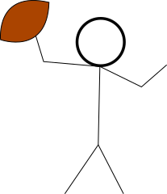

RESTful Web APIs
With RESTful APIs, our programs can communicate with an API’s server using HTTP protocol. Many of the websites you know and love offer RESTful Web Services, including Facebook, Twitter, PayPal, JitBit and Jira - just to name a few.
My program (client)
RESTful Web API (server)

Slide 5
RESTful Web APIs
These services allow us to use data from these sites to make our programs’ wildest dreams come true.
My program (client)
RESTful Web API (server)
Notes:
Use = read and write

Slide 6
RESTful Web APIs
There are many guidelines to follow to be true a true RESTful Web API. I recommend looking them up.
You may want to make a RESTful Web API for your own company’s site one day!
Make amazing applications with the data Web APIs offer!
My program (client)
RESTful Web API (server)

Slide 7
RESTful Web APIs
The REQUEST
A message to the web API using HTTP protocol
HTTP Protocol: The same way language that our browsers use to request the web pages that we request!
My program (client)
RESTful Web API (server)
Notes:
That’s the same standard of communication that our browsers use to request the beautiful web pages that we request from servers all over the world - everyday!

Slide 8

The HTTP Request
What can we request?
We can request:
Data from the server (GET)
To Update something on server (PUT)
To Post something to server (POST)
To Delete from server (DELETE)
Notes:
In this case our Http request will be this football

Slide 9
HTTP Request to JitBit’s RESTful API
A request may contain other information, like username and password to ensure the ‘requester’ has permission to request their request.
GET /ticket?id=10
Notes:
Explain green: base of ticket We include information like this in the headers of the Request. There a tons of fields that can be used in the header of HTTP
Request line: url (request) use params to determine which what info u want
Status line: status code (response)
Headers
Body/ optional

Slide 10
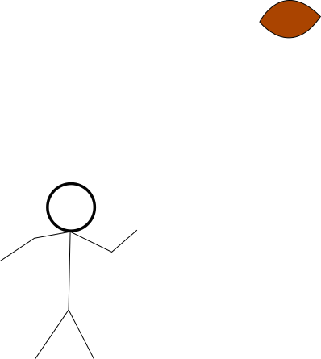
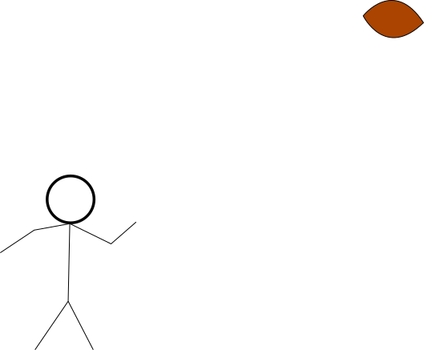






Someone get me the info for a ticket with id 10, pronto!
GET /ticket?id=10
My program (client)
RESTful Web API (server)
RESTful Web APIs

Slide 11

We can’t find ticket #10, boss!!!

Slide 12
The RESPONSE
A message to client (HTTP)
My program (client)
RESTful Web API (server)

Slide 13
The HTTP Response
What’s in the response?
JSON DATA
XAML
HTML pages
Images
Et cetera…
And a Response code!
200s = SUCCESS
400s = NOT FOUND (404)
Notes:
So instead of the server going up in flames when it can’t find our desired resource, we return a 404 status code. That’s why we see 404 when a page is not found

Slide 14
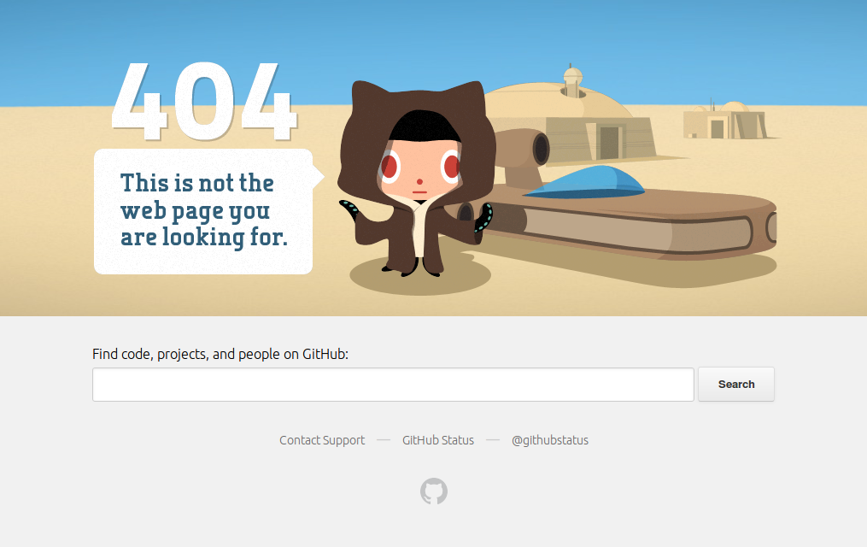



smh…
Notes:
404 error pages, usually when we try to access something on a web server that can not be found

Slide 15
Notes:
Instead of the server burning to the ground because of a bad request

Slide 16
The RESPONSE
A message to client
My program (client)
RESTful Web API (server)

Slide 17
Looks like there is no ticket 10.
404
My program (client)
RESTful Web API (server)
RESTful Web APIs

Slide 18
GET /ticket?id=9
Someone get me the info for ticket with id 9, pronto!
Let’s try ticket 9
GET /ticket?id=9
My program (client)
RESTful Web API (server)
RESTful Web APIs
Notes:
getTicket vs ticket

Slide 19
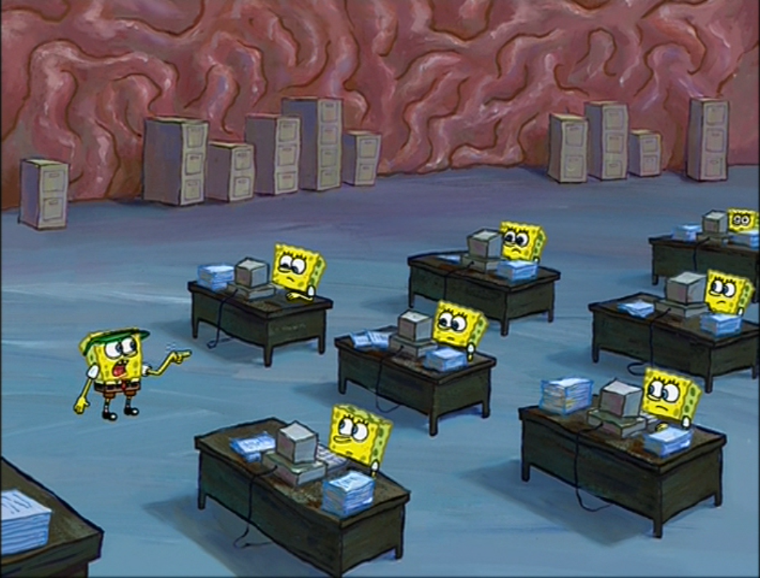
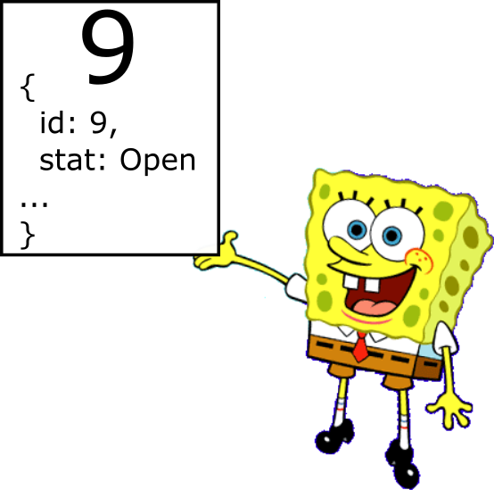
Found it, boss!!!
Notes:
Instead of the server burning to the ground because of a bad request

Slide 20
TICKET 9 request SUCCESS. I have all the information on ticket 9!
200
200
200
My program (client)
RESTful Web API (server)
RESTful Web APIs

Slide 21
HTTP Response from JitBit’s RESTful API
status: 200
Header:
Content-type: JSON,
Server: Apache/3.0
Body: {
id: 9,
tech: “Chase Guyer”,
status: “In progress”
}
Notes:
So instead of the server going up in flames when it can’t find our desired resource, we return a 404 status code. That’s why we see 404 when a page is not found

